Slide 1


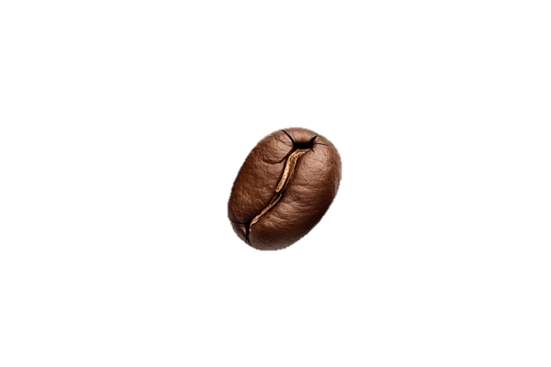


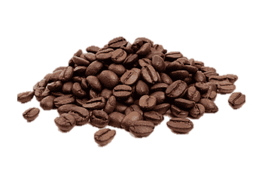
S
CA
E
TUDY
Presented By-
Sarfaraj Durrani

Slide 2
Bean Battle:
Nescafe v/s Starbucks

Slide 3
Bean Battle:
Nescafe v/s Starbucks

Slide 4
Who are
Nescafe Buyer ?

Slide 5
Who are
Nescafe Buyer ?
refers to customers who purchase products or services from Nescafe.
Characteristics -

Slide 6
LIFESTAGE
EMPLOYMENT
LIFESTYLE
EDUCATION
AGE
Lifestages could include young singles, small families, and adult singles, indicating a diverse mix of individuals who may prioritize convenience and affordability.
Family-Oriented: families looking for practical and economical solutions to their coffee needs.
Employment: May consist of full-time workers, part-time employees, and students, indicating a varied mix of occupations.
likely to be more focused on home life and may prefer convenient products that fit a budget-conscious lifestyle.
Home-oriented
Budget-conscious lifestyle.
Education Level: A mix of educational backgrounds, including some college and trade degrees, mostly reflecting practical and immediately applicable skills.
Target Audience: More likely to include individuals who prioritize cost-effective options rather than brand prestige.
Nescafe Buyers:
Young Singles: 9.7% of buyers.
Small Family: 8.1% of buyers.
Adult Singles: 18.6% of buyers.
Nescafe Buyers:
Employed Full-Time: 49.1%
Employed Part-Time: 10.1%
Unemployed: 6.8%
Nescafe Buyers:
Some College or University: 21.3%
2-Year College Degree: 9.7%
4-Year College Degree: 19.6%
Characteristics -

Slide 7
LIFESTYLE
EDUCATION
AGE
INCOME
Lifestages could include young singles, small families, and adult singles, indicating a diverse mix of individuals who may prioritize convenience and affordability.
Family-Oriented: families looking for practical and economical solutions to their coffee needs.
Education Level: A mix of educational backgrounds, including some college and trade degrees, mostly reflecting practical and immediately applicable skills.
Target Audience: More likely to include individuals who prioritize cost-effective options rather than brand prestige.
Age Range: Likely to encompass a broader age range, appealing to young adults through to middle-aged consumers.
Younger Adults: May include a focused demographic of younger buyers who are economically influenced.
Income Level: A higher proportion of shoppers in lower to middle-income ranges (under $40k and $40k-$60k), suggesting price sensitivity is a key factor in purchasing decisions.
Budget-Conscious: Strong inclination toward budget products that fit their financial constraints.
Nescafe Buyers:
Some College or University: 21.3%
2-Year College Degree: 9.7%
4-Year College Degree: 19.6%
Nescafe Buyers:
18-34 years: 23.1%
35-54 years: 26.1%
55+ years: 15.8%
Characteristics -
Nescafe Buyers:
Income <$40k: 34.9%
Income $40k-$60k: 17.3%

Slide 8

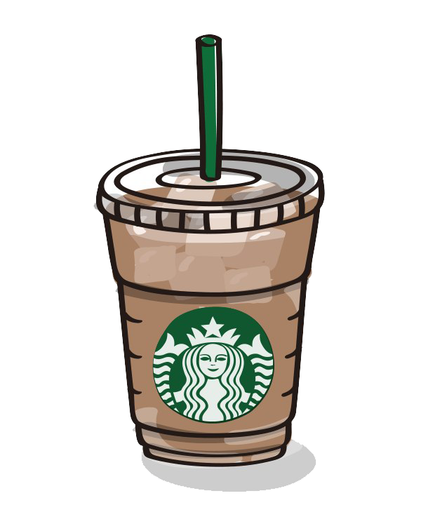
Who are
STARBUCKS Buyer ?
refers to customers who purchase products or services from Starbucks.

Slide 9
CHARACTERISTICS -
Lifestage
Employment
Lifestyle
Education
3
4
1
Lifestages might
predominantly be young
couples, adult couples, and
urban affluent lifestyles.
Socially Engaged: Larger families and younger family setups where outing for coffee is common, reflecting a social lifestyle.
2
Typically includes more
full-time employed
individuals with higher
job statuses, indicating
professional careers.
Urban and socially
active, often indulging in
outings and experiences
over purely practical
purchases. They also engage
in coffee culture significantly.
More likely to hold four
-year degrees or higher,
reflecting an educated consumer base valuing premium options.
Starbucks Buyers:
Employed Full-Time: 51.9%
Employed Part-Time: 10.1%
Unemployed: 3.3%
Marketplace Knowledge:
Often educated about the benefits
of premium products and willing to
pay for those benefits due to higher educational backgrounds.
Starbucks Buyers:
Young Couples: 4.7% of buyers.
Large Younger Family: 13.9% of buyers.
Urban Affluent: 9.7% of buyers

Slide 10
Lifestyle
Education
Age
Income
3
4
5
6
Urban and socially
active, often indulging in
outings and experiences
over purely practical
purchases. They also
Engage in coffee culture significantly.
More likely to hold
four-year degrees or . higher, reflecting an educated consumer base valuing premium options.
Generally attracts younger
consumers, particularly millennials and Gen Z, who may have more disposable income to spend on premium coffee experiences.
More evenly distributed
among higher income
brackets (above $60k),
indicating an ability to spend more on coffee purchases.
Marketplace Knowledge:
Often educated about the
benefits of premium
products and willing to pay
for those benefits due to
higher educational backgrounds.
Starbucks Buyers:
Income $60k-$80k: 12.1%
Income $80k-$100k: 8.4%
Income ≥ $100k: 27.4%
Starbucks Buyers:
18-34 years: 26.8%
35-54 years: 24.5%
55+ years: 10.6%

Slide 11
NESCAFE SHOPPER’S PREFERENCE :-

Slide 12
NESCAFE SHOPPER’S PREFERENCE :-
01
Shopping Behavior
Nescafe shoppers tend to purchase less frequently, with a significant portion buying monthly. They prefer traditional retail settings, mainly supermarkets and convenience stores.
02
Health and Sustainability
Nescafe shoppers show moderate concern for health and sustainability but are less likely to invest in premium options.
03
Interests and Hobbies
Nescafe buyers lean towards more solitary activities like cooking and home entertainment, suggesting a preference for home-based consumption.
04
Exposed Touchpoints
Nescafe shoppers are influenced mostly by traditional advertising methods, like TV ads, while Starbucks shoppers are responding to digital and social media marketing.
05
Financial Attitudes
Nescafe buyers are highly price sensitive and prioritize value for money, influencing their purchasing decisions heavily.
06
Online Shopping
Nescafe shoppers predominantly favor in-person shopping, showing low engagement with online channels.

Slide 13
STARBUCKS SHOPPER’S PREFERENCE :-
4
Exposed Touchpoints
Shopping Behavior
1
The preferences for touchpoints highlight the differing marketing strategies that would work best for each brand.
Starbucks shoppers exhibit a higher frequency of daily purchases, indicating a reliance on the café experience, primarily purchasing in-store.
5
Financial Attitudes
Health and Sustainability
Starbucks buyers are more open to spending on premium products, displaying less price sensitivity than Nescafe consumers.
2
Health and sustainability are significant considerations for Starbucks shoppers, evidenced by their higher percentages.They demonstrate a willingness to invest in sustainable options.
6
Online Shopping
Interests and Hobbies
3
Starbucks shoppers are more active online, with a notable proportion purchasing weekly, reflecting a willingness to engage with e-commerce.
Starbucks consumers actively engage socially and involve themselves in travel and fitness, indicating a more dynamic lifestyle.

Slide 14






STARBUCKS SHOPPER’S PREFERENCE :-
Shopping Behavior
1
4
Exposed Touchpoints
Starbucks shoppers exhibit a higher frequency of daily purchases, indicating a reliance on the café experience, primarily purchasing in-store.
The preferences for touchpoints highlight the differing marketing strategies that would work best for each brand.
Health and Sustainability
5
Financial Attitudes
2
Starbucks buyers are more open to spending on premium products, displaying less price sensitivity than Nescafe consumers.
Health and sustainability are significant considerations for Starbucks shoppers, evidenced by their higher percentages. They demonstrate a willingness to invest in sustainable options.
Interests and Hobbies
3
6
Online Shopping
Starbucks consumers actively engage socially and involve themselves in travel and fitness, indicating a more dynamic lifestyle.
Starbucks shoppers are more active online, with a notable proportion purchasing weekly, reflecting a willingness to engage with e-commerce.

Slide 15
Here are insightful comparisons based on the analyzed data:-
Characteristic | Nescafe Shoppers | Starbucks Shoppers | Best | Reason
Age Preference | Stronger in ages 35-44 (23.2%); Index: 138 | Broader distribution leaning towards Millennials (27.4%) | Starbucks | Engages younger demographics, making it more relevant in lifestyle markets.
Education Level | Varied; 7.2% less than high school | Higher education representation, but less pronounced | Starbucks | Higher education focus aligns with premium products and branding.
Online Shopping Preference | 63.6% agree shopping online saves time | 38% prefer physical stores, distrust fresh food online | Nescafe | Higher percentage indicating a preference for convenience and efficiency.
Staying Updated on Health Trends | 13.20% | 15.40% | Starbucks | Higher engagement in health trends indicates a preference for better nutrition.
Vitamin and Supplement Use | 43.6% proactive | 36.20% | Nescafe | Comparable, but slightly more proactive on supplement use.
Cooking | 38.70% | 35.50% | Nescafe | Higher interest suggests consumer engagement with food preparation at home.
Baking | 33.50% | 29.40% | Nescafe | Emphasizes DIY kitchen activities, aligning with brand's home experience.
Online Learning Platforms | 19.3% (mobile devices) | 20.1% (social media) | Starbucks | Higher engagement on social media allows for effective marketing.
Catalogs/Brochures | 4.90% | 4.50% | Starbucks | Social presence enhances brand visibility.
Budget Consciousness | 31.8% cautious | 30.20% | Nescafe | Higher percentage indicates a more careful approach to spending.
Comfort with Debt | 33.5% discomfort with debt | 27.30% | Nescafe | Reflects cautious financial attitudes among consumers.
Health Management | More proactive, willing to manage health | Focused on experience; healthy options are secondary | Nescafe | More emphasis on personal health management.
Shopping Experience | Convenience-driven, looking for deals | Quality-driven, valuing experience | Starbucks | Higher focus on creating an experiential shopping atmosphere.
Overall Summary |  |  | Overall | Both brands excel in different areas, appealing to distinct consumer values.

Slide 16
Demographics
Shopping Attitudes
How do Nescafe shoppers differ from Starbucks shoppers?
02
01
Budget-Driven vs. Quality-Driven: Nescafe shoppers tend to be more price-sensitive and budget-driven, indicating a preference for value over status. In contrast, Starbucks shoppers might be more quality-driven, associating premium coffee with a status symbol.
Experience with Shopping: Shoppers for Nescafe may find grocery shopping a chore (33.3% share), whereas Starbucks shoppers could view the experience more positively, given the brand's café culture.
Income Levels: Nescafe shoppers tend to be more budget-conscious with a higher representation in low-income categories (under $40k) and middle-income brackets ($40k-$125k). Starbucks shoppers may gravitate more towards high-income brackets, as they are often viewed as a premium coffee brand.
Marital Status: Nescafe consumers include a higher percentage of singles, while Starbucks may appeal more to couples and families who can afford the higher price point.
4
REASON
04
03
Looking into their interests, Nescafe shoppers might have a stronger inclination towards home-based activities (like gardening or home decorating), while Starbucks patrons could be more inclined towards social activities that facilitate coffee culture (e.g., meeting friends at cafés).
Health & Wellness: Nescafe shoppers may prioritize practicality and convenience (such as instant coffee), while Starbucks shoppers are likely to engage more in lifestyle trends related to artisan coffee experiences.
Lifestyle Preferences
Interests & Hobbies

Slide 17
4
REASON
01
02
Income Levels: Nescafe shoppers tend to be more budget-conscious with a higher representation in low-income categories (under $40k) and middle-income brackets ($40k-$125k). Starbucks shoppers may gravitate more towards high-income brackets, as they are often viewed as a premium coffee brand.
Marital Status: Nescafe consumers include a higher percentage of singles, while Starbucks may appeal more to couples and families who can afford the higher price point.
Budget-Driven vs. Quality-Driven: Nescafe shoppers tend to be more price-sensitive and budget-driven, indicating a preference for value over status. In contrast, Starbucks shoppers might be more quality-driven, associating premium coffee with a status symbol.
Experience with Shopping: Shoppers for Nescafe may find grocery shopping a chore (33.3% share), whereas Starbucks shoppers could view the experience more positively, given the brand's café culture.
Demographics
Shopping Attitudes
03
04
Health & Wellness: Nescafe shoppers may prioritize practicality and convenience (such as instant coffee), while Starbucks shoppers are likely to engage more in lifestyle trends related to artisan coffee experiences.
Looking into their interests, Nescafe shoppers might have a stronger inclination towards home-based activities (like gardening or home decorating), while Starbucks patrons could be more inclined towards social activities that facilitate coffee culture (e.g., meeting friends at cafés).
Lifestyle Preferences
Interests & Hobbies

Slide 18
How Nescafe can attract or capture Starbucks shoppers?
STRATEGY
STRATEGY
STRATEGY
STRATEGY
STRATEGY
1
2
33
4
5
Enhanced Product Offering
Marketing Strategies
Sensory Engagement
Sustainability Narrative
Loyalty Programs
Develop premium coffee lines or specialty items that mimic the Starbucks experience
Promote the idea of crafting café-style drinks at home or Utilize social media platforms to create a community around at-home coffee experiences
Host local events or pop-up shops that provide tastings of various Nescafe products
Invest in sustainability efforts and communicate those initiatives effectively
Offering discounts or exclusive products for first-time purchasers or regular customers

Slide 19
THANK YOU

Slide 20
THANK YOU

